Slide 1


Building a WLAN to connect FET building and Techno building
Course: CEF 356 – Mobile Communication Protocols
Course Instructor: Dr Nkemeni Valery

Slide 2

Objectives
To Build a basic wireless Local Area Network (WLAN) using eNSP software
Learn the basics configurations of network devices such as switches, routers; APs and terminal devices.
Master the basic functionationalities of network devices

Slide 3
Introduction
Wired LANs are expensive and lack mobility, thus, The increasing demand for portability and mobility requires Wireless LAN (WLAN) technologies. WLAN is now the most cost-efficient and convenient network access mode. It allows users to move within the covered area.

Slide 4
REQUIREMENTS
Software such as
eNSP
Virtual box 5.2.44 (ORACLE)
Wireshark
Winpcap
Personal Computer

Slide 5
PROCEDURE
DATA PLANNING
We used
A ROUTER
AN ACCESS CONTROLER
2 SWITCHES
5 ACCESS POINT
TERMINAL DEVICES

Slide 6
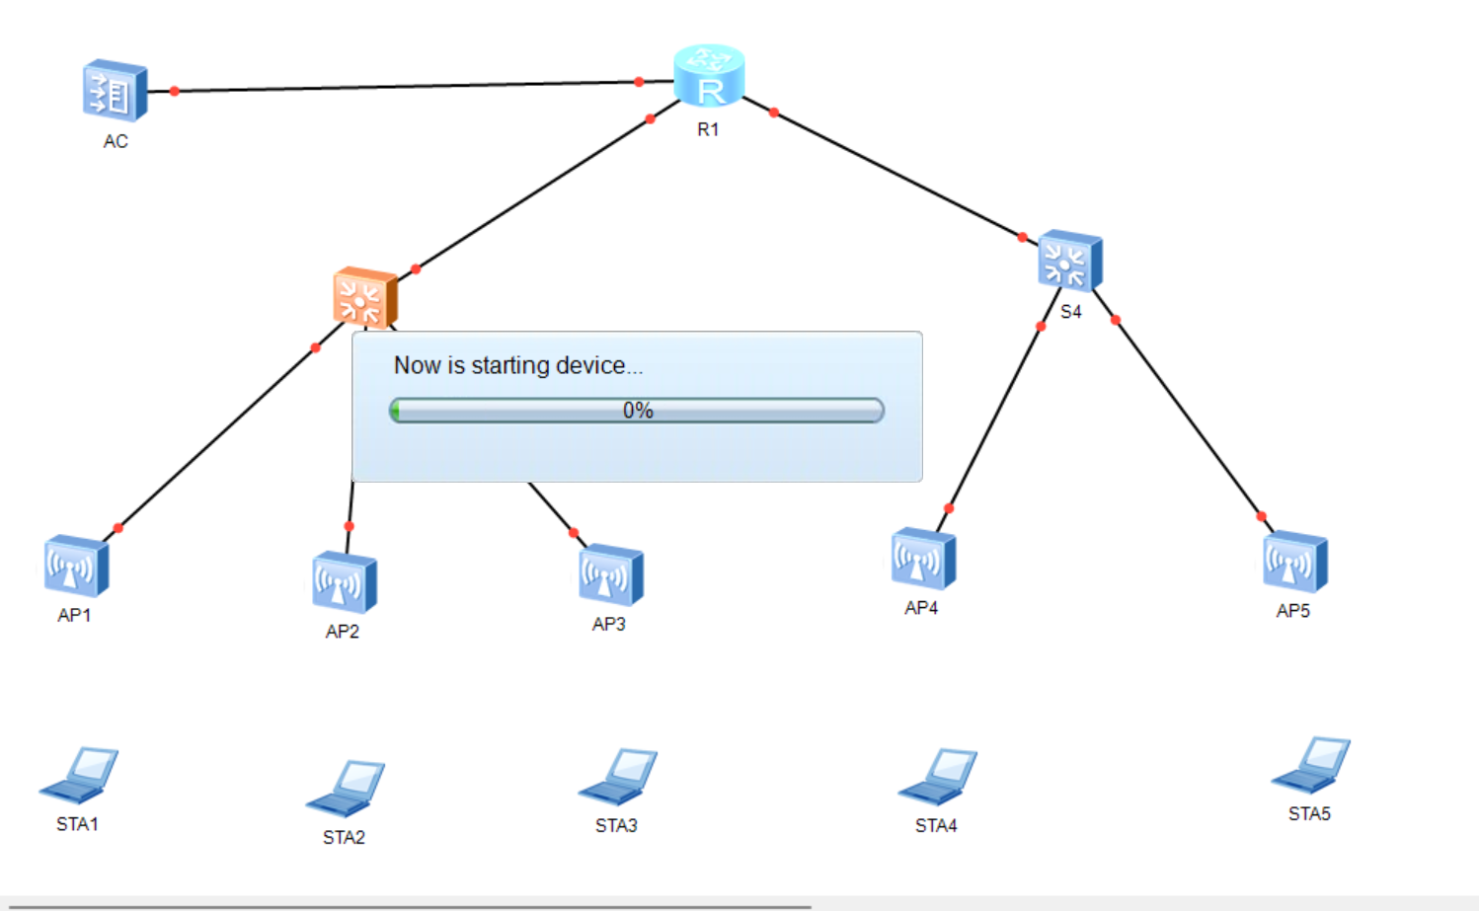
CONFIGURATIONS (1/2)
Start each device

Slide 7
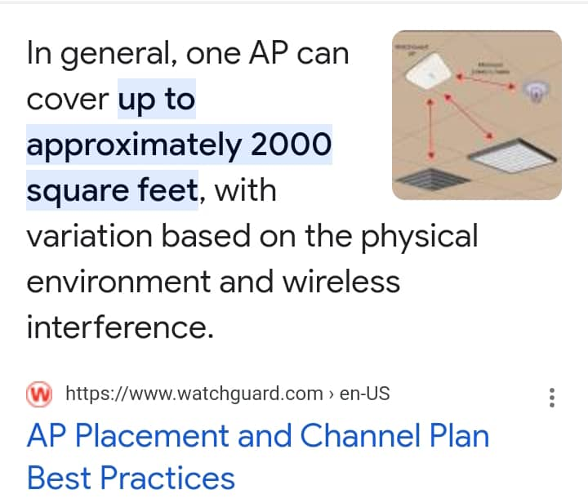
Calculations (1/2)

Slide 8
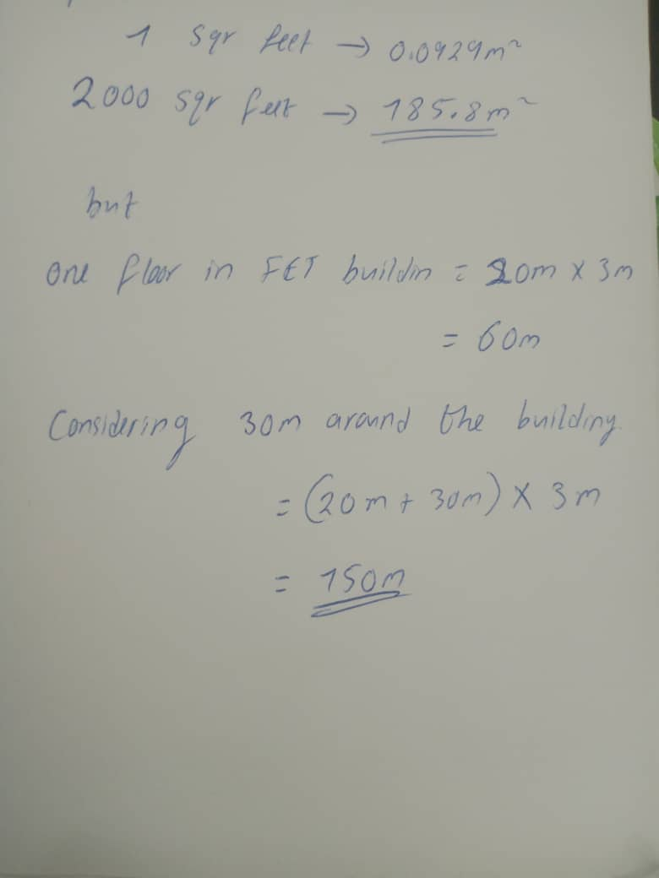
Calculations(2/2)

Slide 9
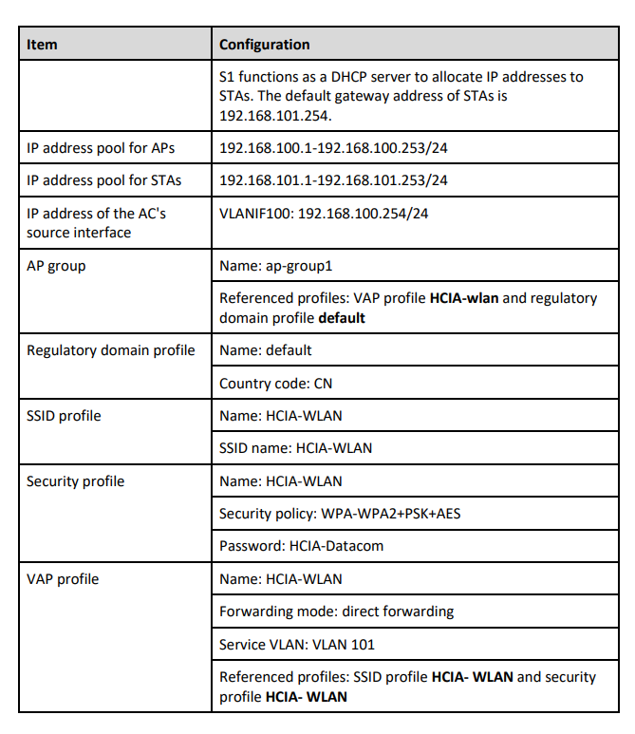
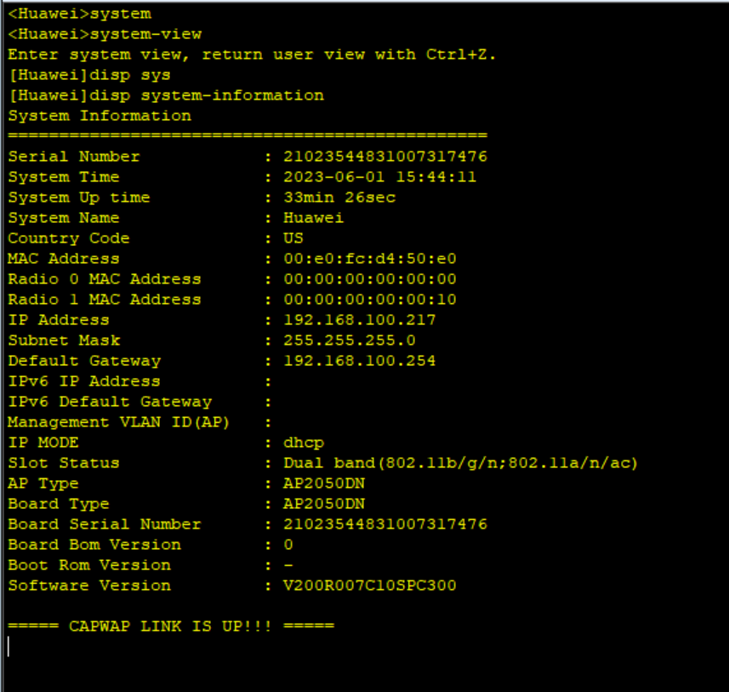
CONFIGURATIONS (2/2)
Configure each interface of the device using the command line interface (CLI)

Slide 10
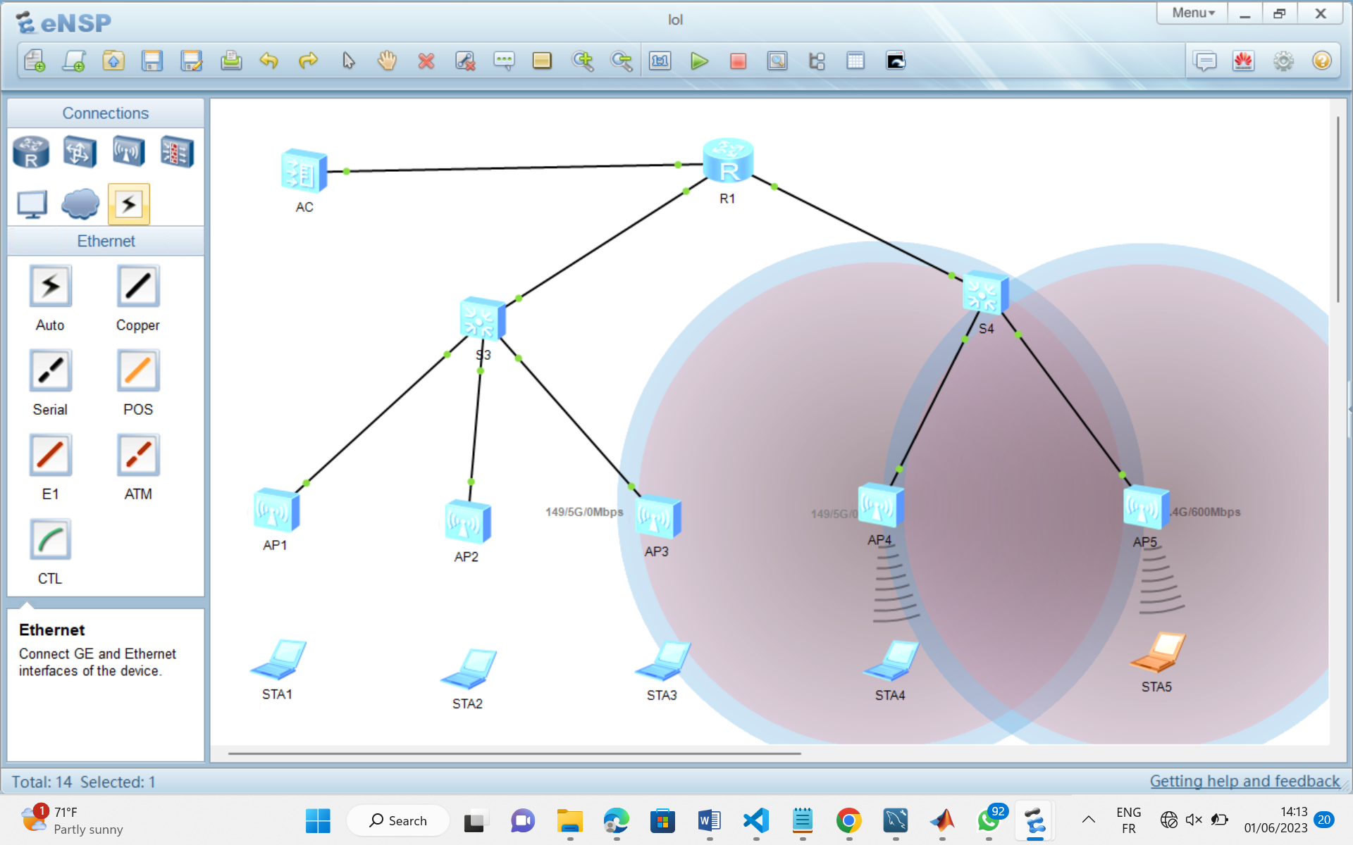
TOPOLOGY/RESULTS
Switch 3 has « 3 » Aps represents
FET building with its 3 floors.
Switch 4 represents techno
building with its 2 floors

Slide 11
Team Members
AGBOR NKONGHO KELLY FE21A126
AHOUMO TEMATEU ROXANE PHILIPPINE FE21A128
KAMCHE YANN ARNAUD FE21A208
KOUOTOU AHMAD BILAL FE21A221
MBI AYAMBA DIANNA FE21A230
NEGUE KWAHAM MAEL GRACE FE21A252
SAMUEL OSOH FE21A303

Slide 12
🎉🎉😊Thank you😊🎉🎉

